Slide 1
Stock Buy-Sell Recommendation using Machine Learning
Gautam Tevatia, Kavita Ganesan, Roshan Herbert
University of Southern California
Computer Science Department
Los Angeles, CA, 90089
Presenter: Tsung-Jung Tsai (蔡宗容)
Date: April 23, 2008

Slide 2
Abstract (1/2)
This project attempts to compare and evaluate stock buy-sell recommendations using machine learning algorithms namely Multilayer Neural Networks and Support Vector Machines. The predictions made using these two learners are then compared with recommendations by analysts. The comparisons were made to determine if machine learning algorithms can predict as well as human analysts. Our findings suggest that our Support Vector Machine prediction model is comparable to predictions made by analysts, but the Neural Networks
model performs rather poorly.

Slide 3
Abstract (2/2)
In terms of profitability however, the Neural Networks model yields the highest returns, followed by the Support Vector Machine model and then the human analysts. This shows that though the learners do not completely agree with the true predictions, these learners yield higher returns, which is a very positive sign and calls for more research in this area.

Slide 4
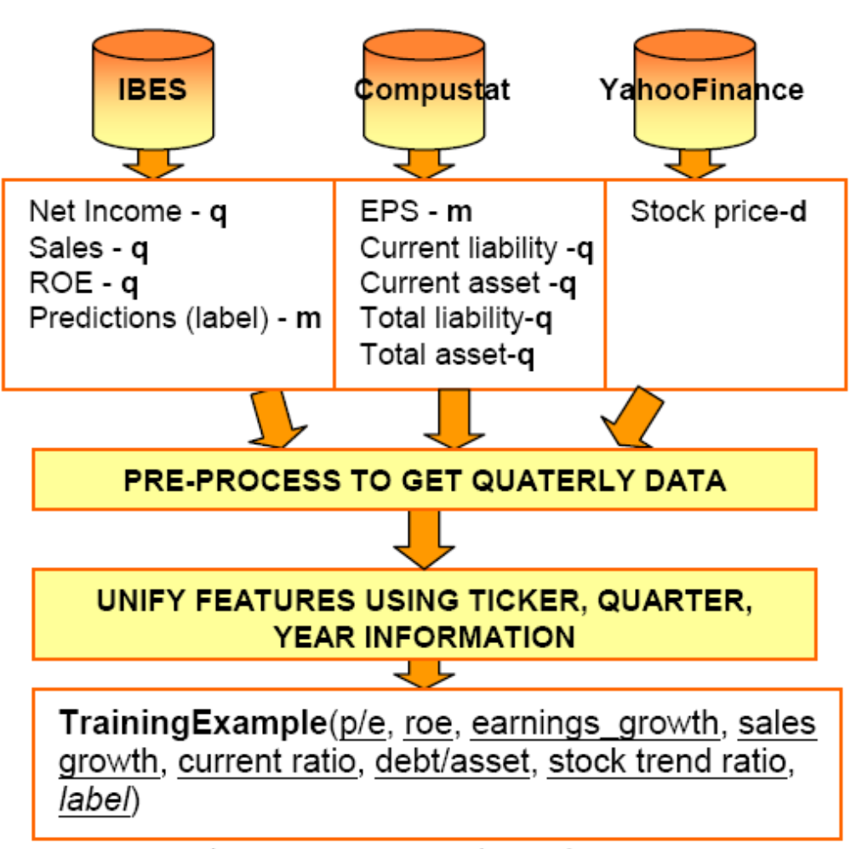

Slide 5
Dataset - WRDS
WRDS is a warehouse of financial, accounting, banking and economics databases. It is a free database for researches.
http://wrds.wharton.upenn.edu/demo/trydemo.shtml
台灣 - 公開資訊觀測站
http://newmops.tse.com.tw/

Slide 6
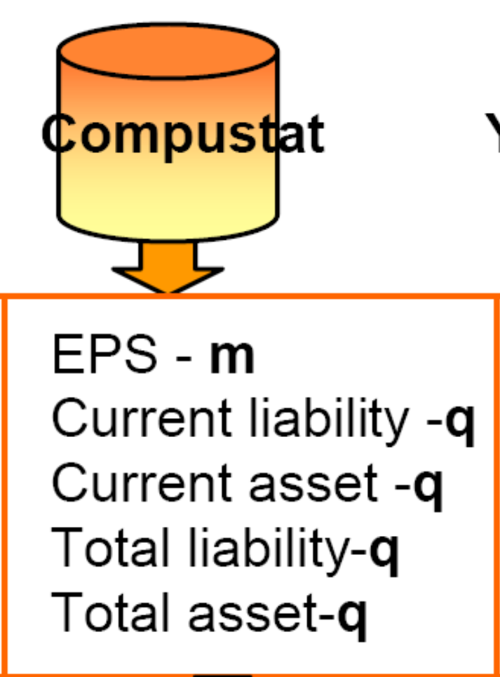
Dataset – WRDS - Compustat
The Compustat provides the annual and quarterly
income statement (損益表),
balance sheet (資產負債表),
statement of cash flows (現金流量表),
and supplemental data items on most publicly held companies.
Notes:
Compustat是一個資料庫
COMPUSTAT是由美國著名的信用評等公司「史坦普」（Standard & Poor's）所發行，收錄以北美地區為主的公司之營運及財務狀況資料庫，是目前文獻中最常被使用的廠商個體資料（firm-level micro data）之一。其應用的研究領域包括有公司資本結構、財務比率、合併與購併、R&D、資本及存貨投資、股市報酬、及資本市場效率等課題。完整的COMPUSTAT資料庫包含有若干不同的database。

Slide 7
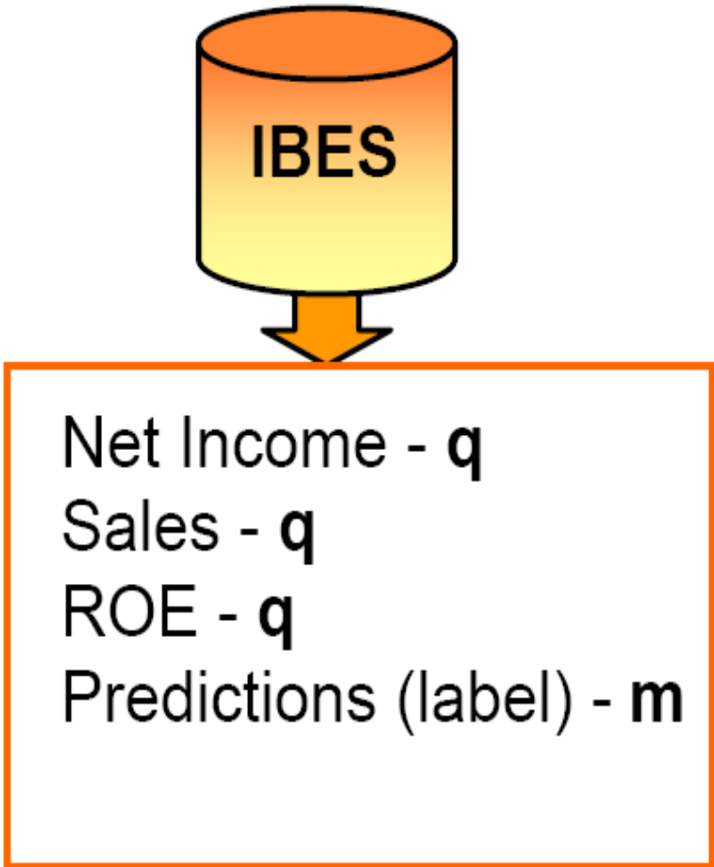
Dataset – WRDS – I/B/E/S
I/B/E/S provides the
return on equity
(ROE, 股東權益報酬率),
price to earnings growth,
(P/E,PER,本益比)
company income and company sales.
Also provides historical stock buy-sell predictions

Slide 8
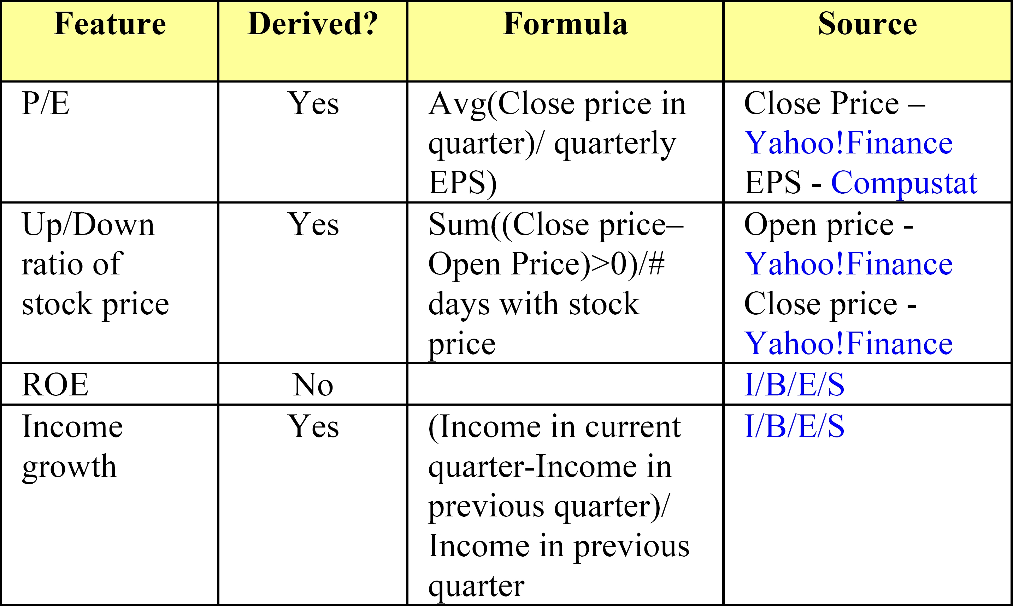

Slide 9
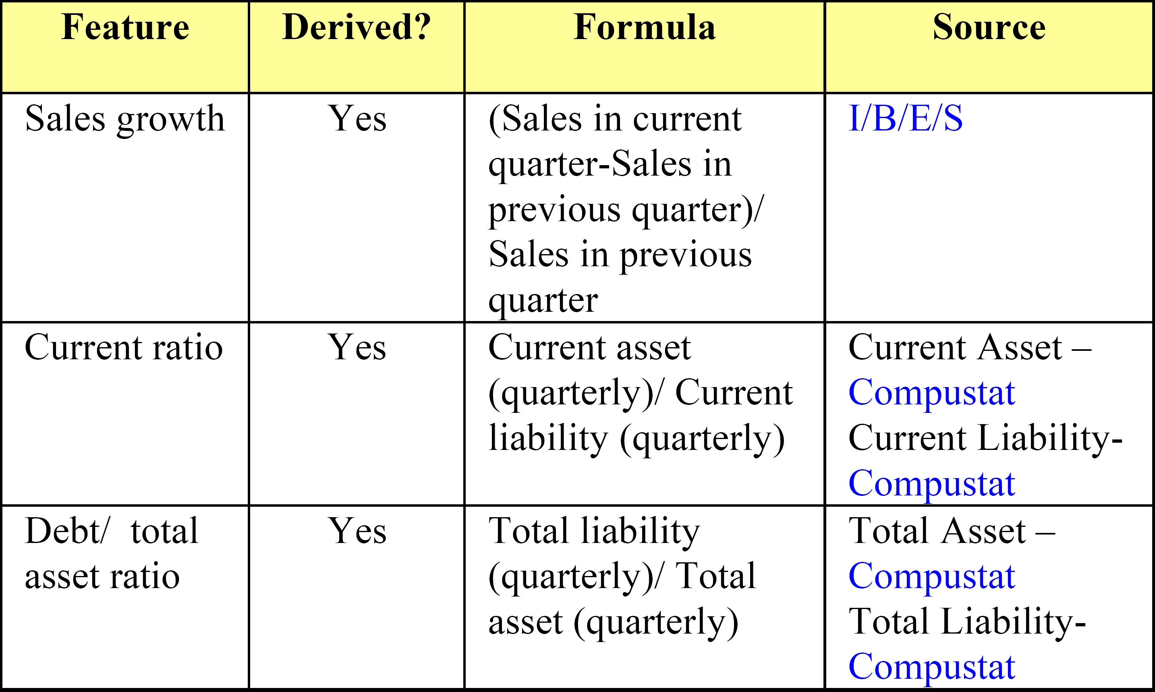

Slide 10
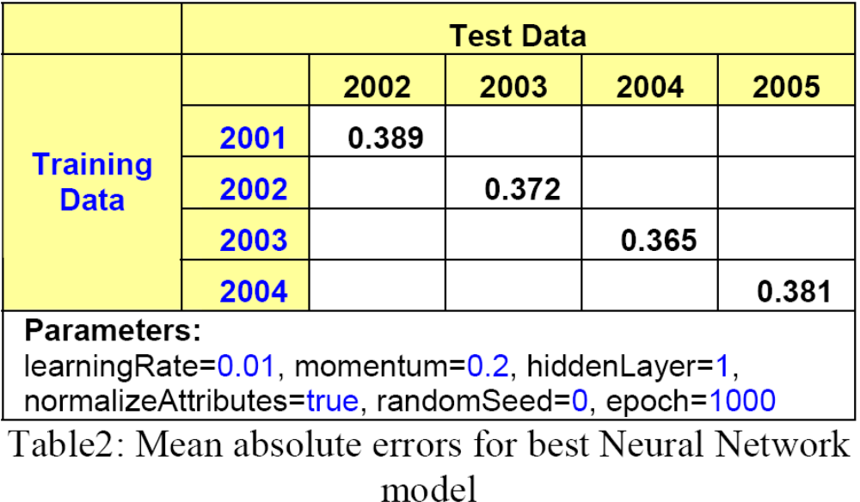

Slide 11
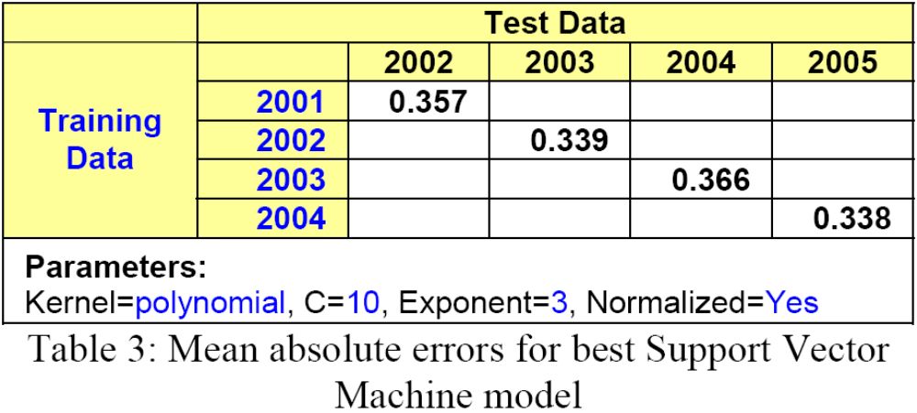

Slide 12
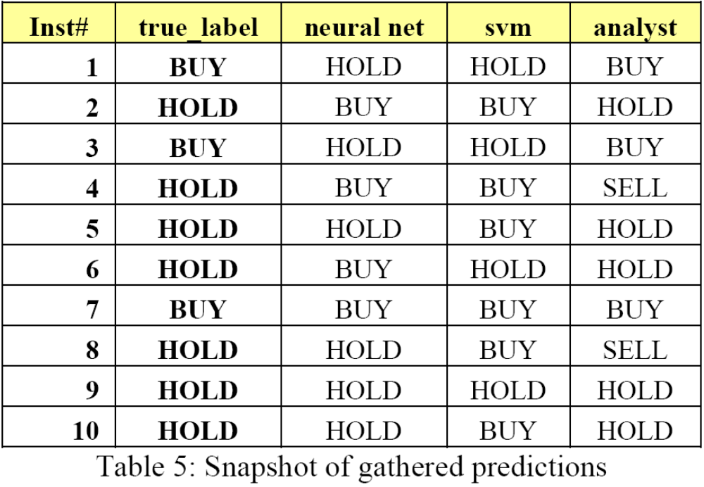

Slide 13
Profitability
For 2002, a loss of $583 was calculated for the analysts’ prediction at the end of the year.
The Neural Network model registered a loss of $1487
The Support Vector Machine model registered a loss of $1950

Slide 14
Discussion (1/2)
One suggestion for improvement would be to experiment with the binning approach of feature values to see if this improves the accuracy of predictions.
e.g.
for the p/e feature, values of 15-30 go into the “good” bin and p/e value of 0-10 go into the “fair” bin.

Slide 15
Discussion (2/2)
Second suggestion would be to increase the size of the training data.
It would be good to experiment with monthly and daily periodicities to see if such predictions are more accurate as opposed to quarterly based predictions.

Slide 16
隨機亂步 (Random walk)?
打破股票分析師的迷思
(四月 21, 2007 — foremuto)
http://blog.swarchy.com/2007/04/21/stock-analyst-prediction-accuracy/
超能力與選股技巧 (2007/05/20)
http://greenhornfinancefootnote.blogspot.com/2007/05/blog-post_7962.html

Slide 17
打破股票分析師的迷思 (1/3)
財經分析師 (financial analysts or stock analysts) 所寫的研究報告（目標公司財務分析、營運展望和市場預測等等）準確性一直惹人爭議。自2002-2003年間，美國華爾街投資銀行和其研究部門相繼爆發了一連串的醜聞之後，這些年收入超過百萬美元的分析師的可信度更是大幅下滑。因此美國政府和投資銀行業展開了整頓行動，嘗試分隔交易和研究部門，以避免利益衝突，並降低假借研究報告的名義為銀行實際的操作行為護航的可能性。

Slide 18
打破股票分析師的迷思 (2/3)
全球知名財經資訊集團 Bloomberg 耗費了相當可觀資源，企圖檢驗這些改革的績效。Bloomberg 在2006年11月出版的報告 (Bloomberg Markets Magazine, November 2006)中，詳細蒐集整理了全世界 35 家研究機構和投資銀行，分佈在亞歐美三大洲，超過 2,500 名分析師，在 2004-2006 年間，針對全球前 200 大企業股價所作的預測。他們發現：全球專業分析師的平均預測準度只有 22%。

Slide 19
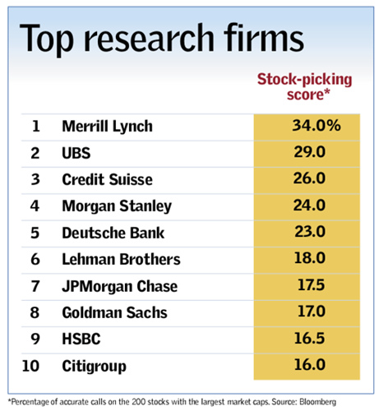

Slide 20
打破股票分析師的迷思 (3/3)
一般分析師會定期針對個別公司股票作推薦評等。最常見的評等方式是把所有公司分成三類：買進 (buy)、賣出 (sell) 和保留觀望 (hold)；或是表現較佳 (outperform)、表現較差 (underperform)和表現平平 (market neutral)。
Bloomberg 的比較方法是：若某分析師認為某股票是「買進」。在他的推薦評等尚未改變之前，若該股票是上漲的，則代表該分析師的預測正確。以此類推，算出「賣出」和「保留觀望」的預測準度。若某分析師總共作過100個推薦，其中30個是正確的，他的預測準度，或打擊率(batting average)，就是 30/100 = 30%。以此方式類推，即可統計出每家投資銀行或研究機構的預測準度。詳細分析方法請參閱原文。

